Slide 1


ROTARACT CLUB OF APS COLLEGE OF ENGINEERING
Sponsored by Rotaract Club of Koramangala

Slide 2





Club ID
8824329
No. of Members
47
Status
Active
@rotaractclubofapsce
Board of Directors :
President : Rtr Sindhu K P
Vice - President : Rtr Bhuvan S M
Secretary : Rtr Mrudula Polur
Joint - Secretary : Rtr K Shamantadas Devaru
Public Image : Rtr Gagan Ganesh
Rtr Mohith Kumar S S
Rtr Samantha V
Treasurer : Rtr Arun K S
Rtr Lakshmi B R
Rtr Suhaan S
Community-Service Director :
Rtr Praveen Kumar N
Rtr Inchara Dayananda
Rtr Deepa S
Club-service Director :
Rtr Harshith S
Rtr Arpitha G Gowda
Rtr Muchumari Pravallika

Slide 3
Sergeant At Arms :
Rtr K R Nagarjun setty
Rtr Samarth Viswanath
Rtr Mohan Kumar N
International-Service Director :
Rtr Anagha Ramesh
Rtr Risha U Shetty
Rtr Bhavana R
Professional Service Director :
Rtr Akshat Singh
Rtr Kavya Priya K
Rtr Adithi Manjunath
Disease Prevention and Control :
Rtr Sushma K T
Rtr SUSHMA S
Rtr Sindhu M
Support The Environment :
Rtr Madhushree K
Rtr Yashwanth M
Rtr Baibhav Chel
Water Sanitation and Hygiene :
Rtr Bindushree N
Rtr Goutham hosamani
Community and Economic Development :
Rtr Komala Devi
Rtr Rakshitha HS
Rtr Gayathri Madappa
Maternal and Child Health :
Rtr Aishwarya V N
Rtr Chandrakumar T S
Rtr Harshitha K
Peace and Conflict Prevention and Resolution :
Rtr Roshan R poojary
Rtr Shivani Thaivallapil
Rtr Vimal raj K
Basic Education and Literacy :
Rtr Harshitha M
Rtr Supriya T
Rtr Prathik Prakash

Slide 4

Charter Installation of office bearers for the rota year 2021 - 22
Event date : 7th Jan 2022
Location : APSCE Seminar Hall
Total hours : 6 hours
No. of Attendees : 40
Funds Spent : 8,000 /-

Slide 5
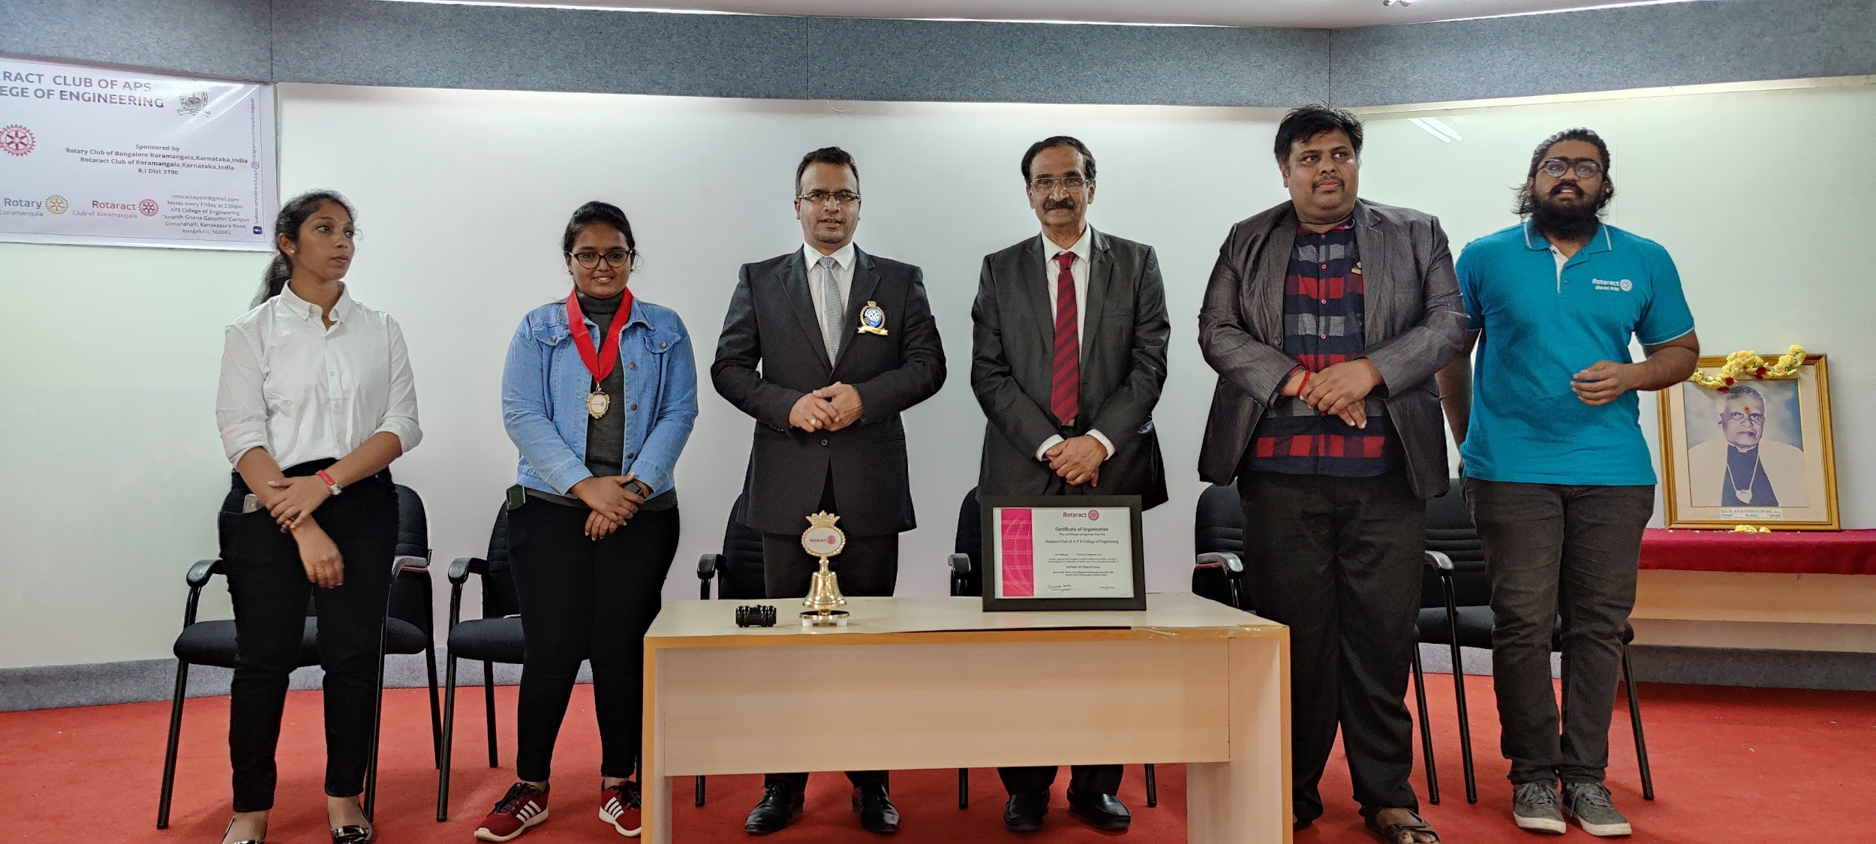
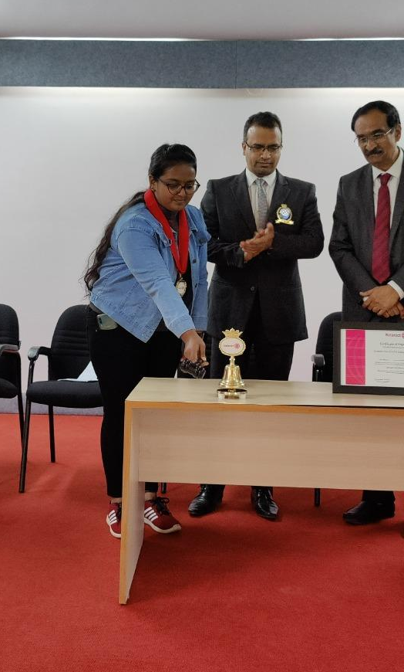
1st Charter Installation of President and Board of Directors-2021-2022

Slide 6
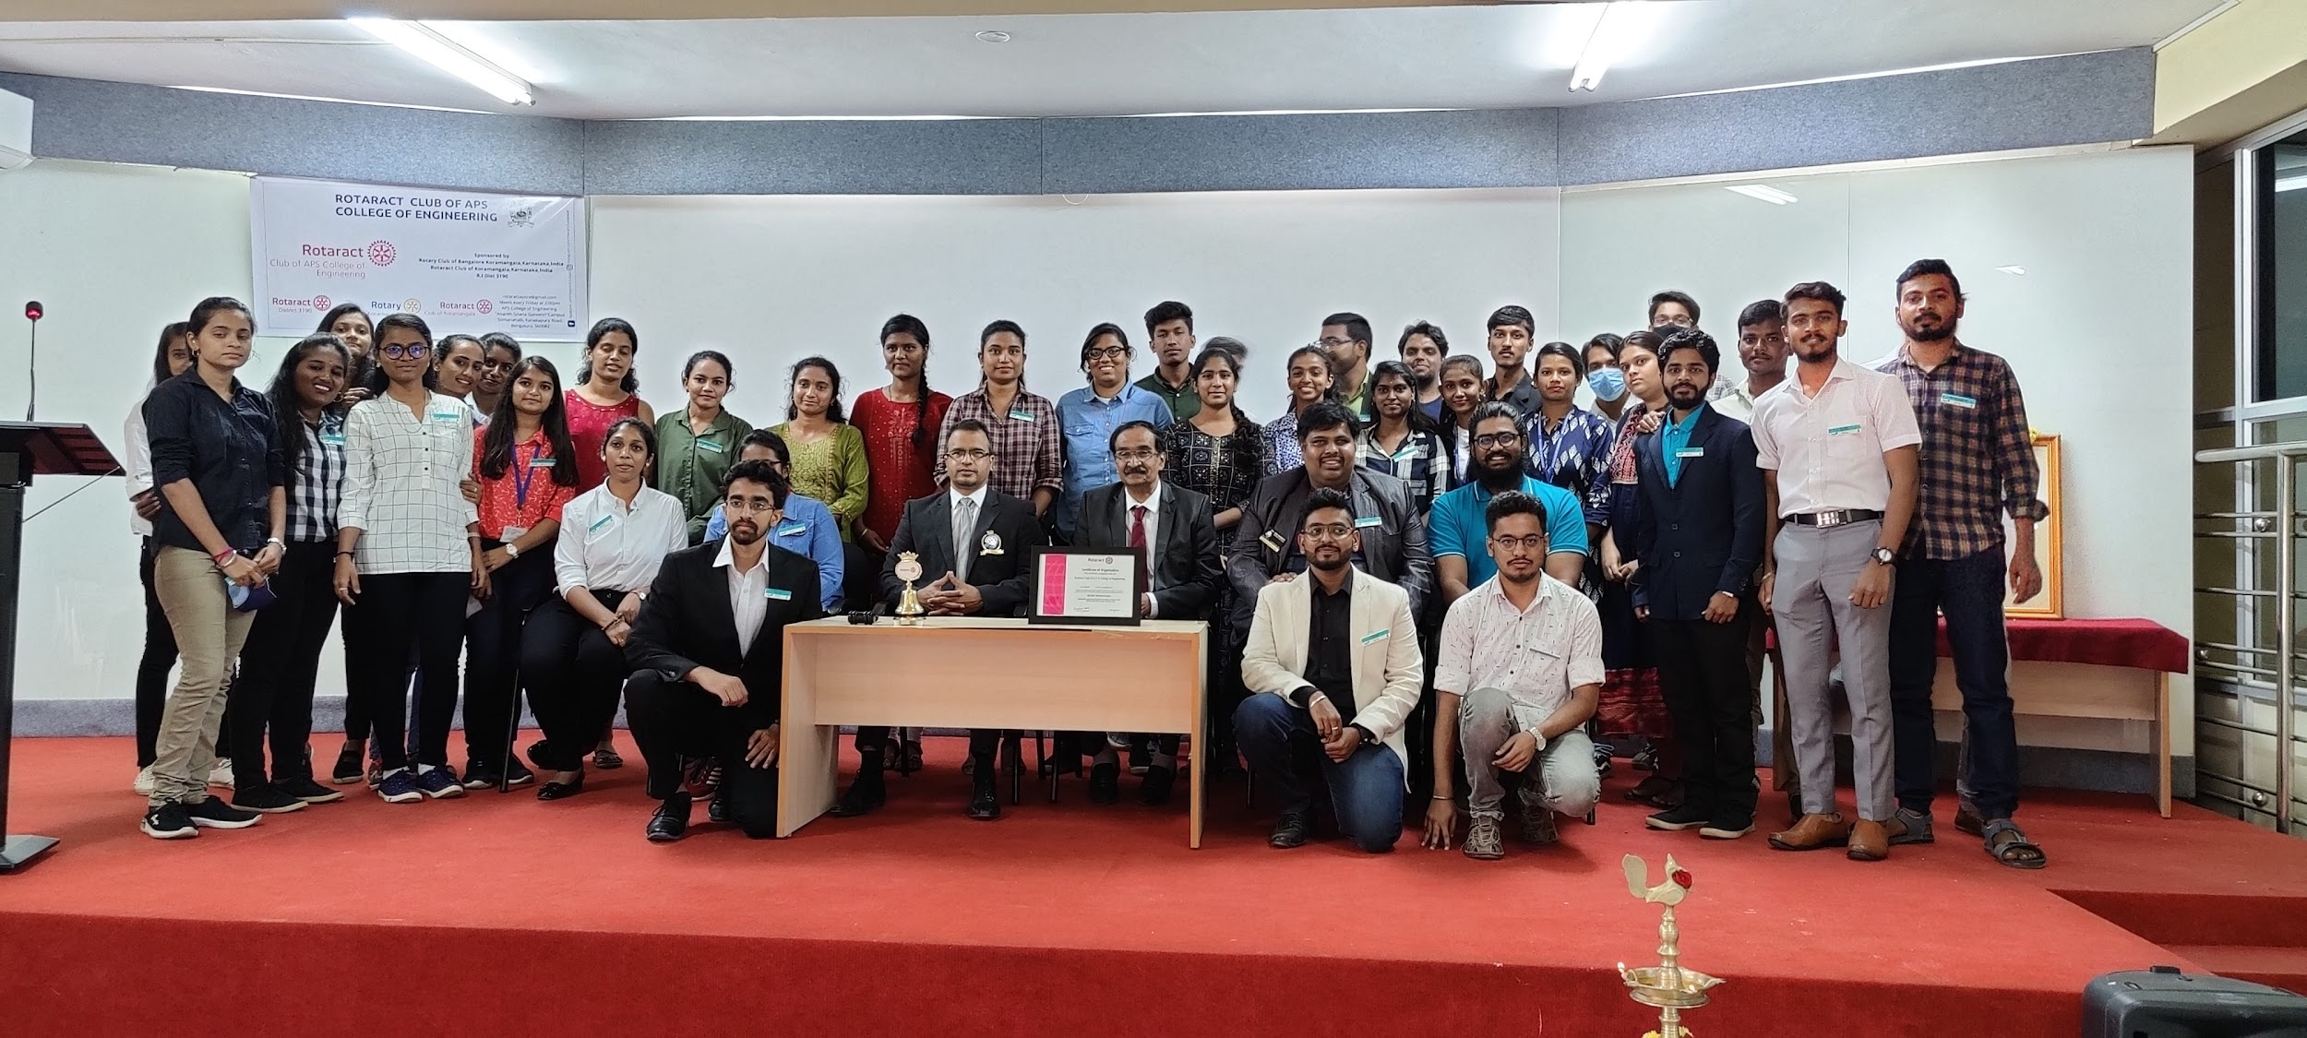
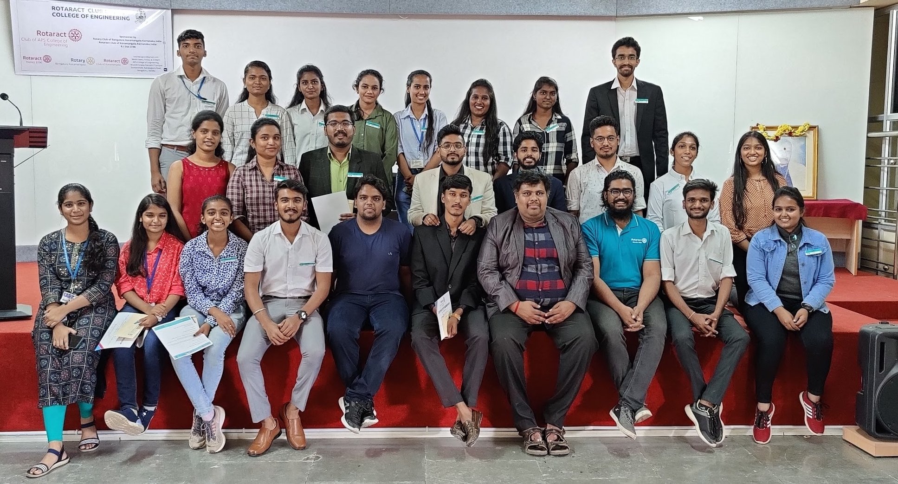
Rotaract Club of Apsce 2021-22
Project Chairs: Rtr. Nagarjun Setty and Rtr. Samarth Vishwanath

Slide 7
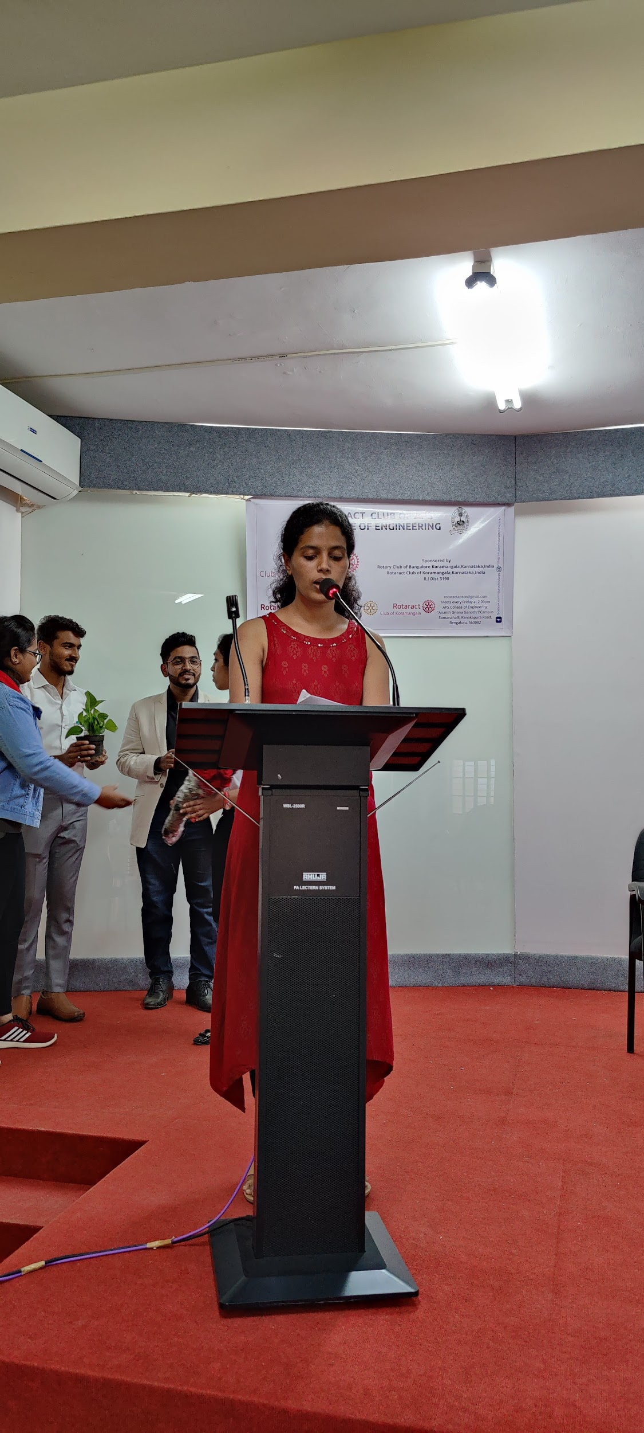
Project Description:
The President and the core members of Rotaract Club of APS
College of Engineering were chosen and were given badges of
their respective roles to render their valuable service to the
Society.
The event was sponsored by Rotary club of Bangalore Koramangala.
Guest of Honour included Dr.A.G.Nataraj the principal of APS College of Engineering and A R Acharya General Secretary APSET.

Slide 8
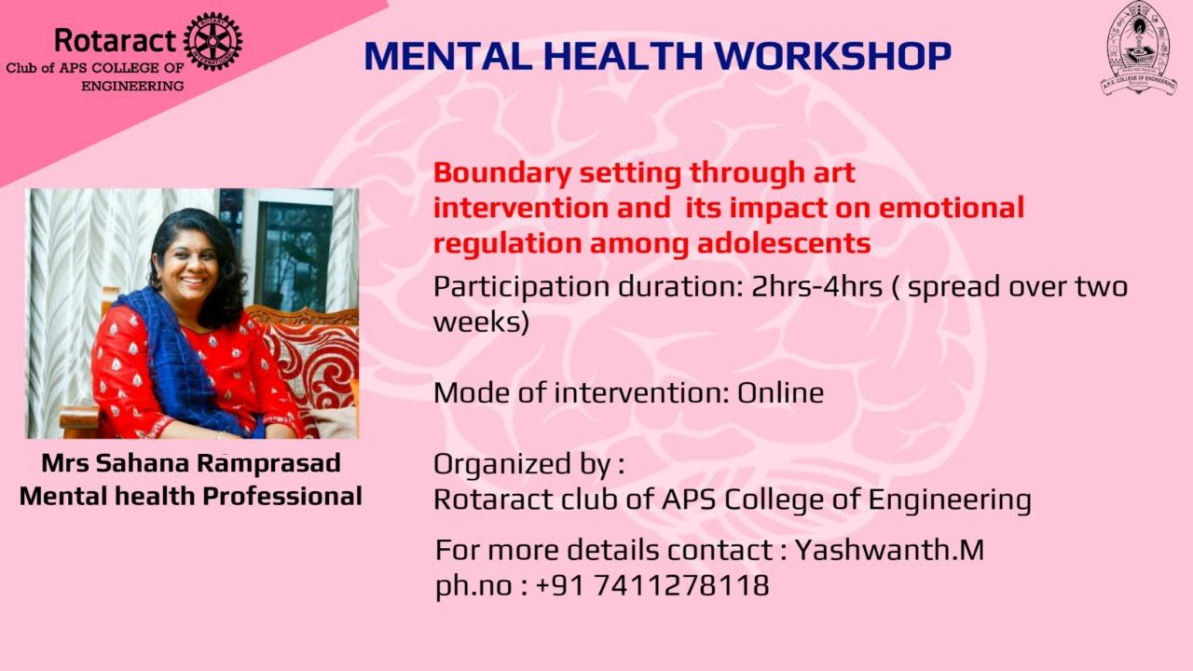
MENTAL HEALTH MATTERS

Slide 9
Date: 9th February 2022
Location: Online Zoom Meet
Type of Project: Stand Alone
No. of Attendees: 60
Project Chairs: Rtr.Sindhu & Rtr.Yaswanth.M
No. of volunteering hours: 4 weeks
No. of Attendees : 20
Funds Spent : NIL
Project Summary:
Creating mental health awareness among the teenagers.

Slide 10
Project Description:
Everyone’s mental health is better when we have a purpose and feel needed.
Mental health is as important as the physical health. Teenagers face a lot of stress and tension during their teenage life. In order to deal with this stress and overcome the tension mental health awareness plays a vital role.
This mental awareness program was conducted by Rotaract club of APS College of Engineering.
18-19 years students of about 100 participated in this program and the online session was successfully conducted by Mrs Sahana Ramprasad, Mental health professional.

Slide 11

Event date : 27th February 2022 | Location : Online | Total Hours spent : 6 hours

Slide 12
German Language Sessions:
'One language sets you in a corridor for life. Two languages open every door along the way.'
Rotaract Club of Palmville in collaboration with our partner clubs bring to you a free, online GERMAN LANGUAGE SESSION from our certified trainer, Debbie Julius with more than 10 years of teaching experience in this language.
🗓 Date: 12th February 2022, Saturday
🕓 Time: 4PM to 6PM
💻 Platform: Zoom
No. of Attendees : 05
Funds Spent : NIL

Slide 13

Event Date: 30th January
Location : Government Kannada and English Model School.
Total hours spent : 7 hours

Slide 14
A project hosted by Rotaract Bangalore West, it's aim was to paint an old government school and give it a fresh look.
7 Rotaractors along with Secretary made an Active participation and contributed their best.
No. of Attendees : 07
Funds Spent : NIL

Slide 15

Event Date: 12th February 2022
Location : Online
Total hours spent : 7 hours
No. of Attendees : 200
Funds Spent : NIL

Slide 16
Project Summary:
Various job opportunities from different companies for the present youth.
Project Description:
Students from various colleges participated in this job fair and could choose the best job with a great salary.
25 well-known and top companies came forward to choose the students with great talent.
The APS College students of rotary club also supported in this job fair efficiently and effortlessly.
It was organised under Yuvatva Paathshala.

Slide 17
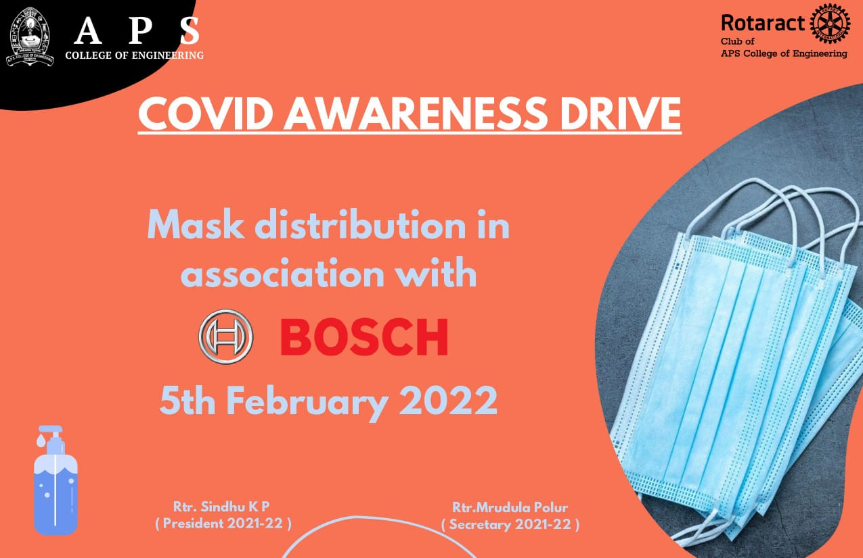
Date : 5th February
Location : Kaggalipura Somanahalli T. K. Falls
Total Hours Spent : 5 Hours
No. of Attendees : 30
Funds Spent : NIL

Slide 18
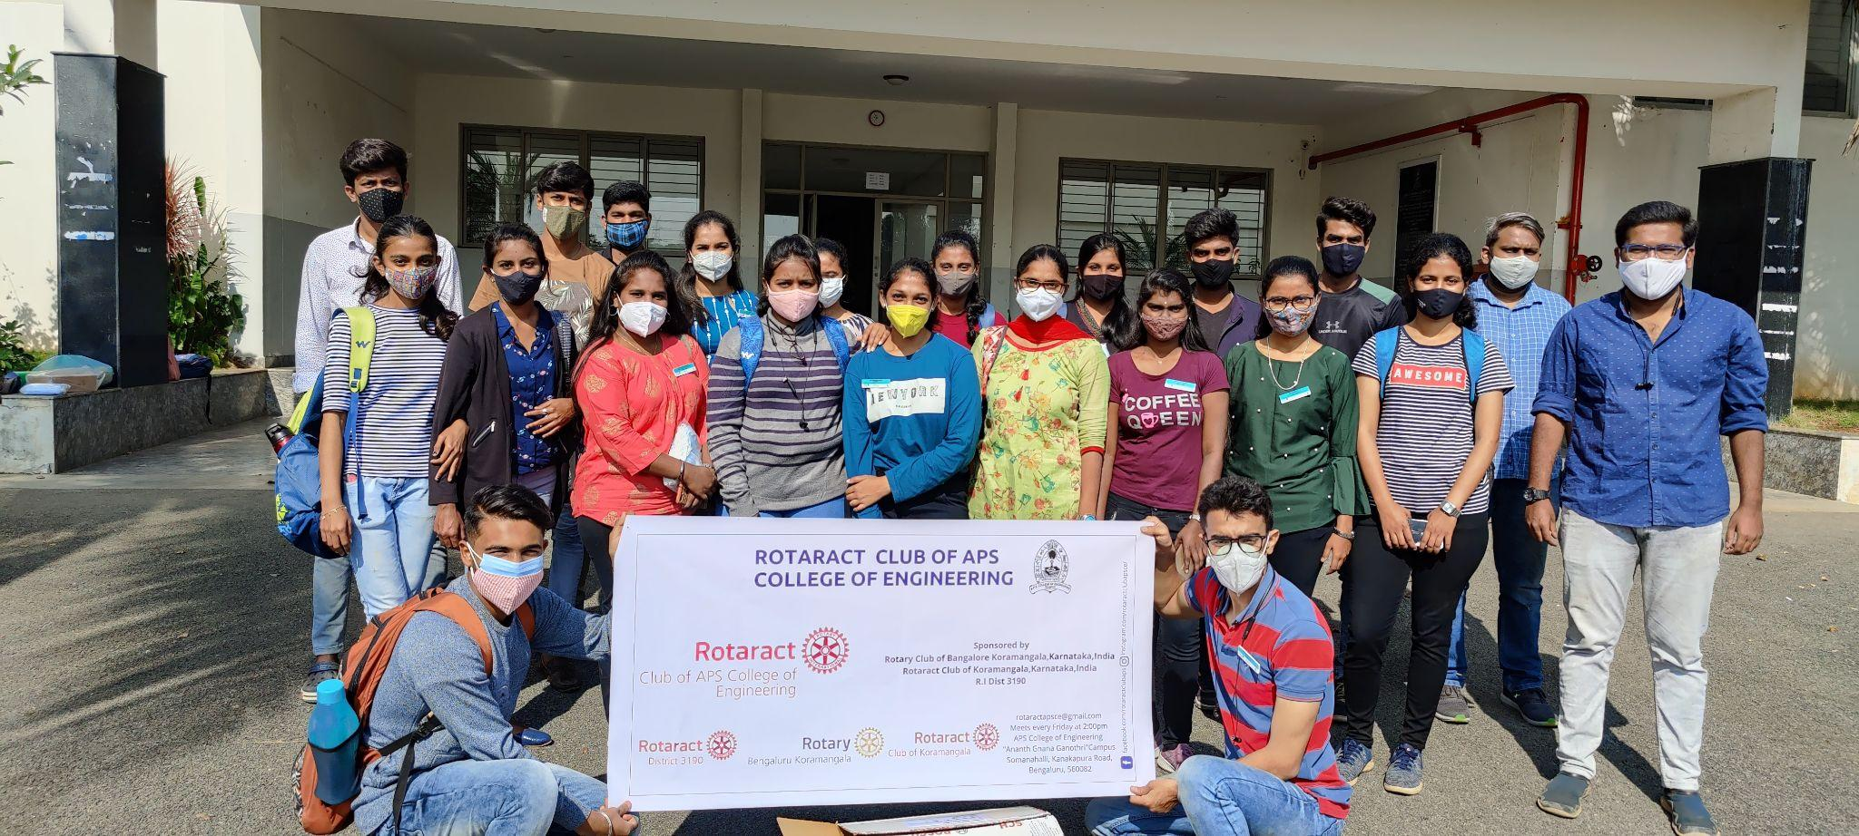
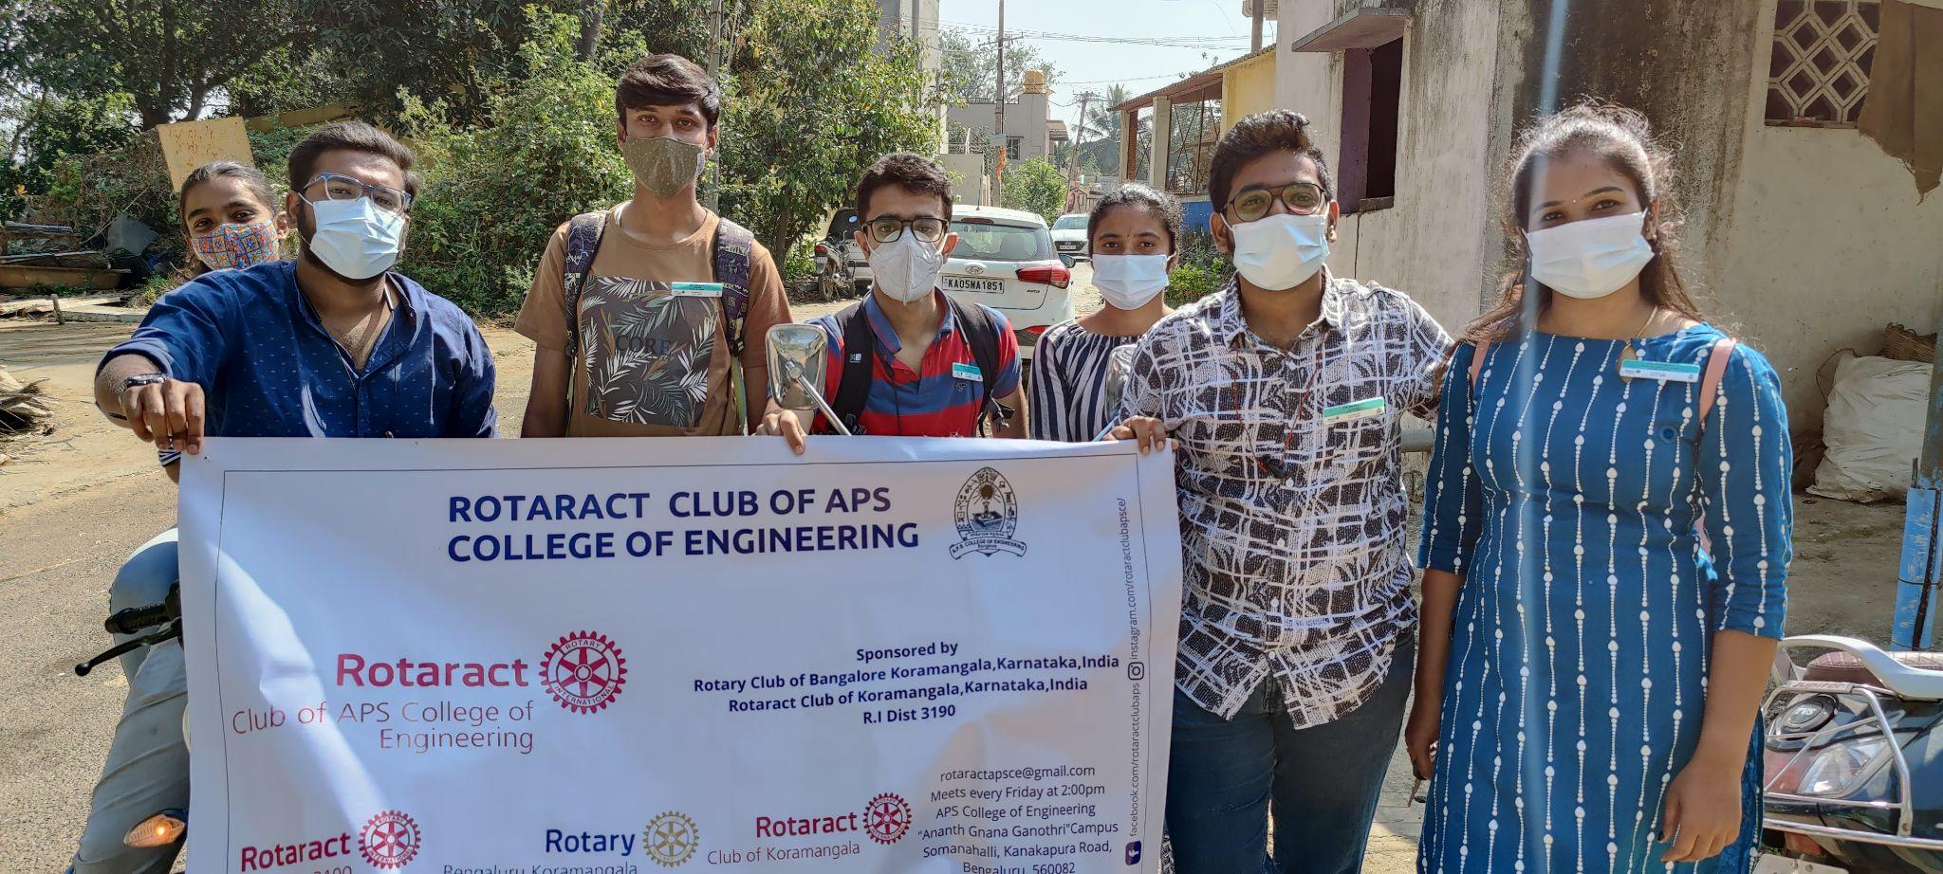
Masks have become a vital part of our new normal.With this new normal it's important to create an awareness about covid and masks. RacAPSCE in association with BOSCH had a Covid awareness drive.We had been to rural parts of Somanahalli and Kaggalipura including the Kaggalipura rural govt school and created an awareness about masks and it' s importance.
Little fun and exploration with team is Very important and mandatory when We all are with our club.
Thank you everyone for actively participating and making the event successful.

Slide 19
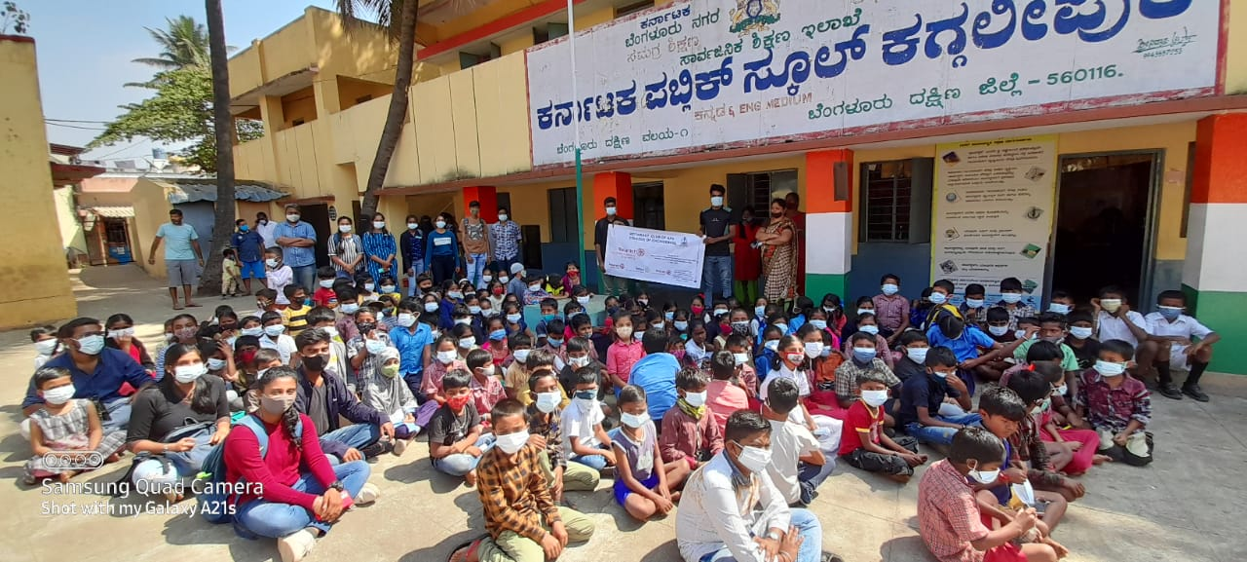
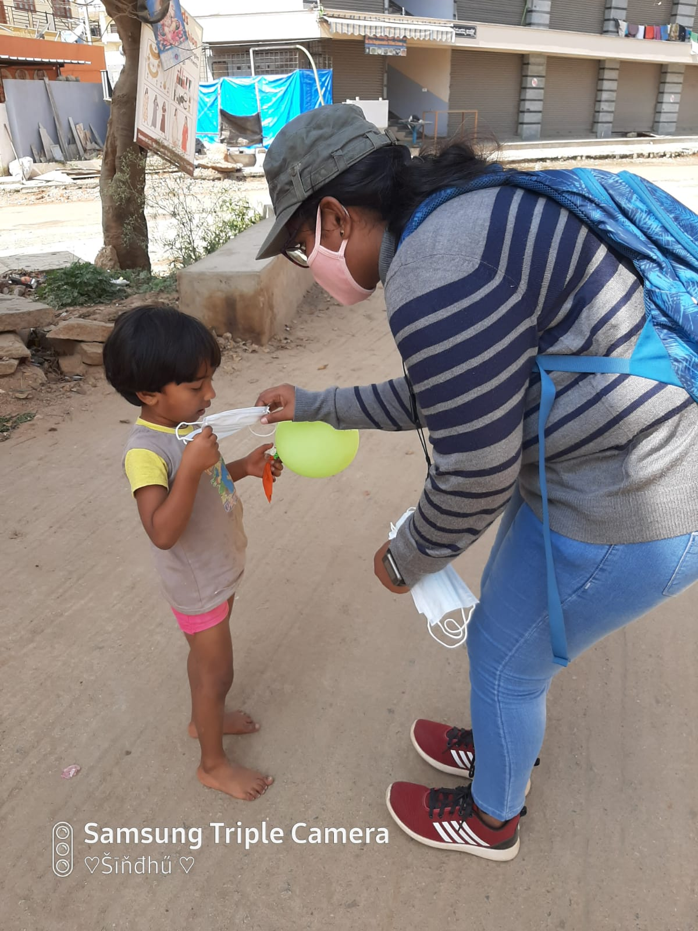
In view of the world wide spread of Corona Virus, Rotaract Club APS College of Engineering, Somanahalli has organized a covid awareness drive in collaboration with BOSCH on 05/02/2022 at Somanahalli and Kaggalipura. Rtr Sindhu KP, President Rotaract Club APSCE, Rtr Mridula Polur, Secretary, Rtr Samarth Viswanath shared their knowledge about the Corona Virus, Safety Measures to prevent from virus, Symptoms of Corona Virus and how the virus is spreading among people. They also clearly explained the ways to improve our immunity of body and food style which could prevent from viral infections. All the Rotaract Club members participated in the program and got exposure about the corona Virus. The program informed about the “DOs” & “DON’Ts” to be followed to get rid of the disease as the infection is very contagious in nature causing serious health problems to the people of many countries including India.

Slide 20

Event date : 27th February 2022 | Location : Uttarahalli UPHC Yelachenahalli UPHC Koramangala UPHC | Total Hours spent : 6 hours

Slide 21
Rotaract Club of Koramangala in collaboration with Rotary Bangalore Koramangala
In order to mark National Immunization Day also known as the Pulse Polio Immunization Programme,💉 welcomes all volunteer towards the noble cause to contribute towards creating a Polio Free World.
No. of Attendees : 17
Funds Spent : NIL

Slide 22
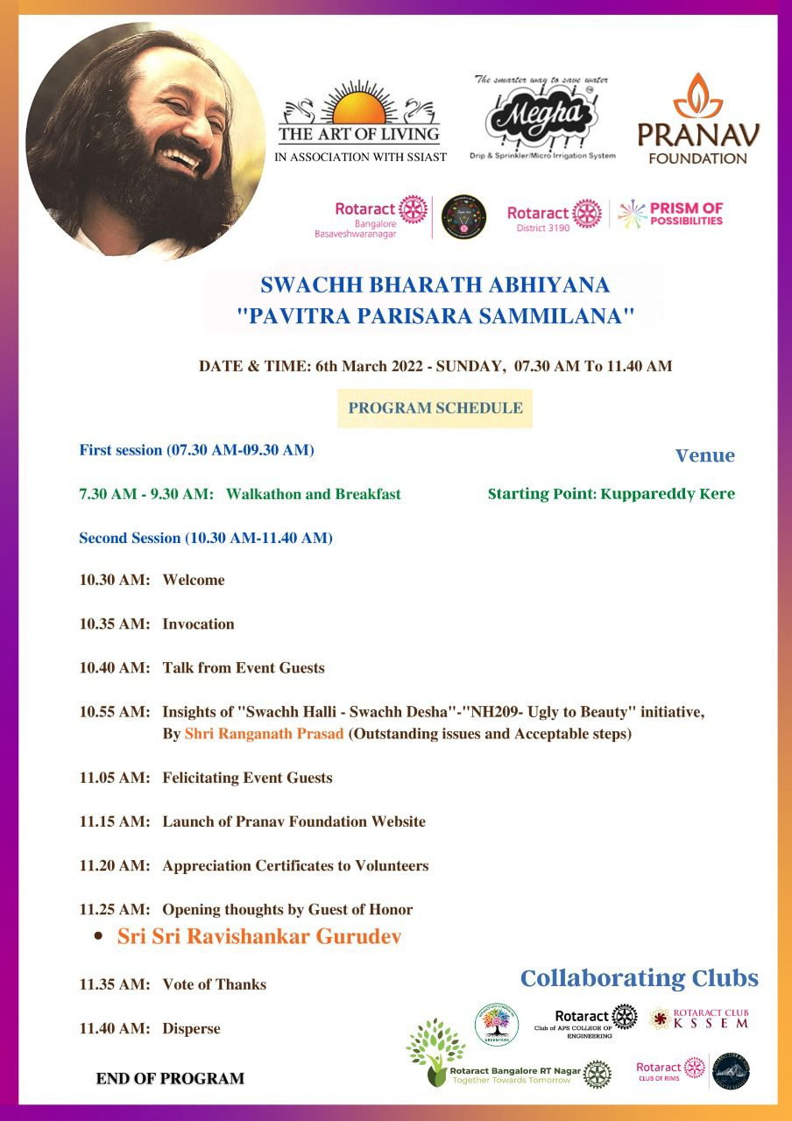
SWACHH BHARATH ABHIYANA
"PAVITRA PARISARA SAMMILANA"
The main objective of this initiative is to create awareness among the local villagers of Agara & Kaglipura about SWACHH BHARATH ABHIYANA
& Conversation of Water Bodies Around the villages. ( We recently has done Lake Cleanathon drive )

Slide 23
Event date : 6th March 2022
Time : 7am to 11.30am
📍 Walkathon Start Point :
Kuppareddy Lake
🔗 Google Maps : https://maps.app.goo.gl/1r6Kf74P4w9owCme8
To
📍Walkathon End Point
The Art of living International Center
https://maps.app.goo.gl/aMEA1YoKTaw2spmy6
Funds Spent : NIL
No. of Attendees : 12

Slide 24
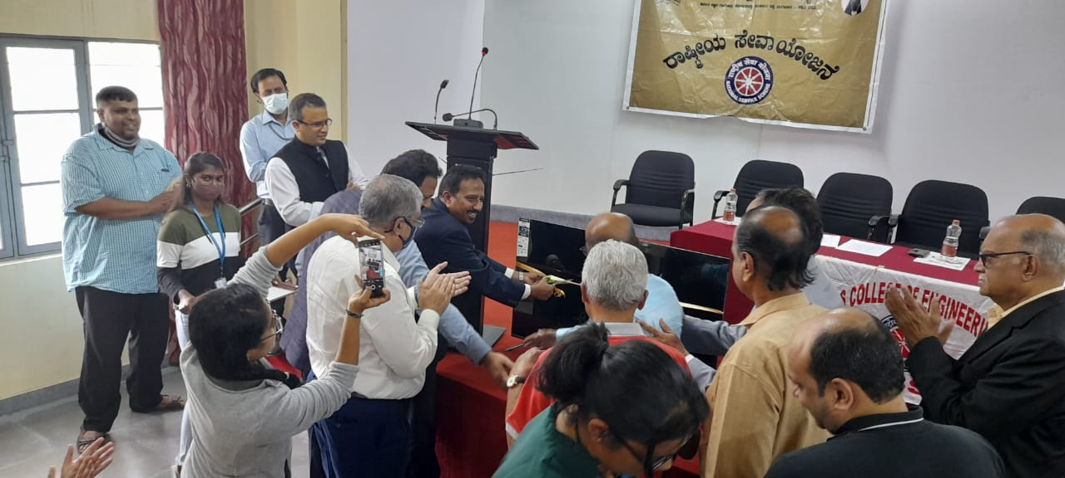
Blood Donation
Date : 26th October 2021
Location : APS College of Engineering
Total Hours spent : 6 hours
The event began by welcoming the Rotary Action Group of AB Rotarians.
The event included blood donation from wilful volunteers, eye screening, distribution of masks and a program was conducted on menstrual Hygiene for the rural school children.

Slide 25
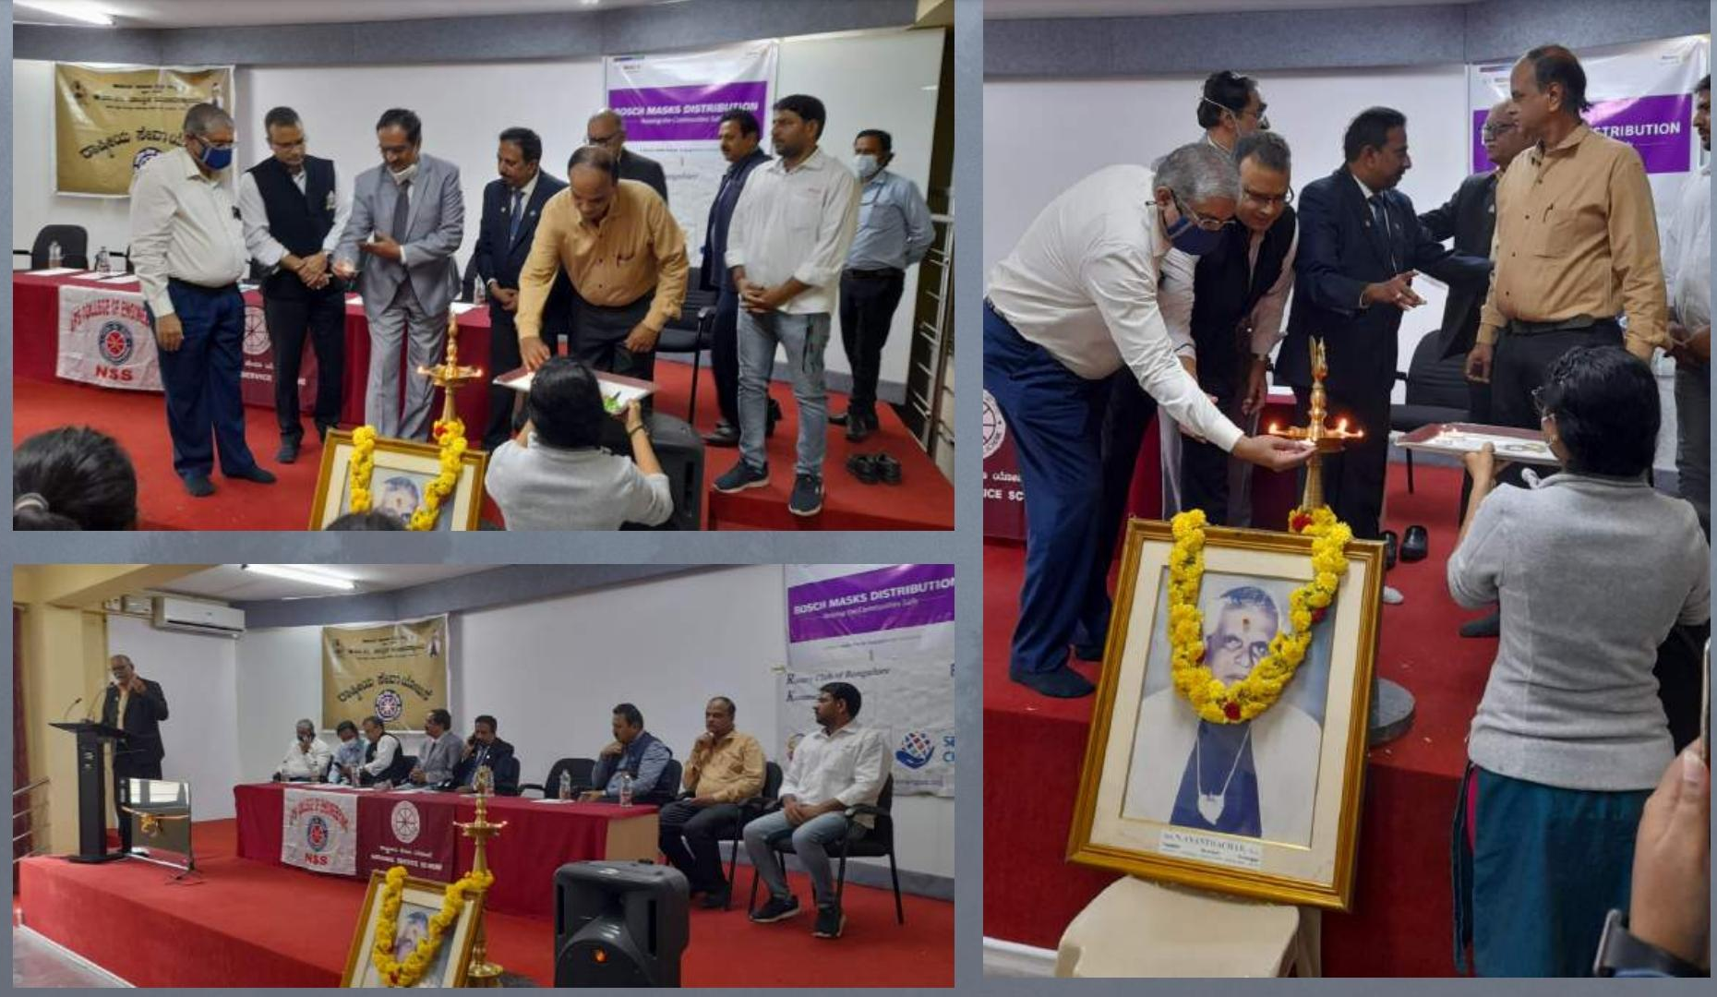
No. of Attendees : 60
Funds Spent : 3,000 /-

